Slide 1
E-Commerce Web Application Big-Data Project
Group Name: Map Reduce
Jagpreet Singh Sethi, Sachin Kant Misra
Prashant Bhowmik, Tatsiana Hreben
Charles Gibson

Slide 2
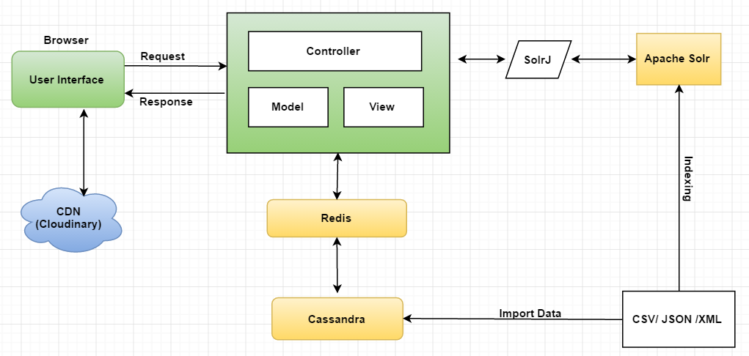
E-Commerce Web Architecture

Slide 3
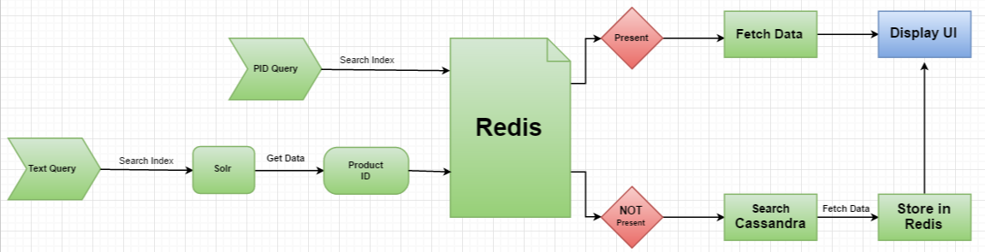
Process Flow Diagram

Slide 4
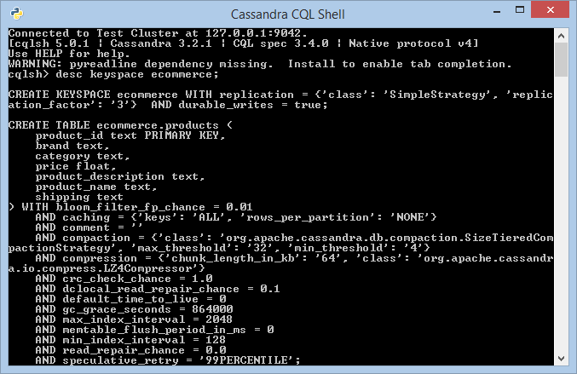
Cassandra Database Schema
Keyspace :
Ecommerce
Table :
Products

Slide 5
Cassandra Data Import
The data has been imported to the Cassandra Database using the following command :
copy products from 'Dataset.csv' with header=True;
Dataset used:

Slide 6
Apache Solr Schema
Creating node : Products
solr create -s 2 -rf 2 -c products -d basic_configs
Appending Schema.xml to add index fields
<field name="product_name" type="text_general" indexed="true" stored="false"/>
<field name="product_description" type="text_general" indexed="true" stored="false"/>
<field name="category" type="text_general" indexed="true" stored="true"/>

Slide 7
Indexing Documents
Indexing done on product_name, product_description and category
Command used:
java -Dtype=text/csv -Durl=http://localhost:8983/ solr/products/update -jar post.jar Dataset.csv

Slide 8
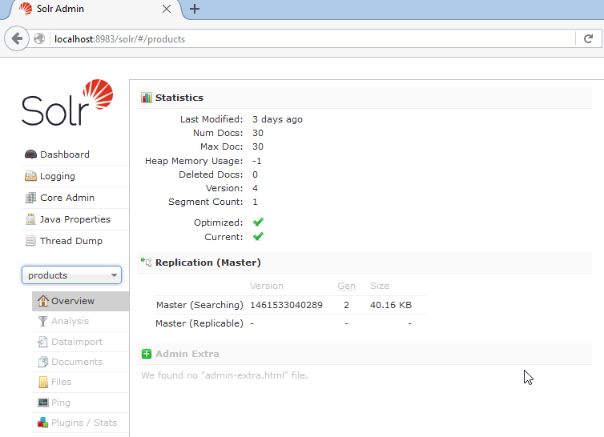
Solr Dashboard

Slide 9
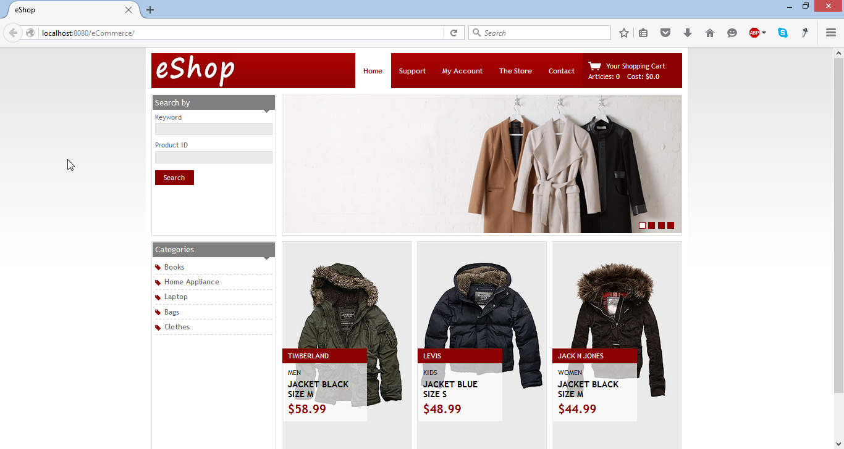
Website Homepage

Slide 10
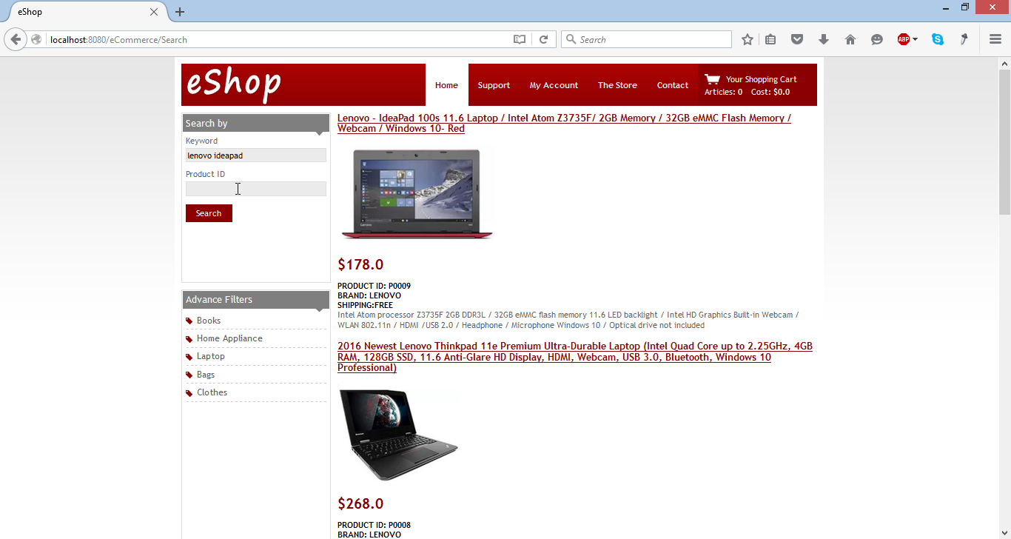
Text Search

Slide 11
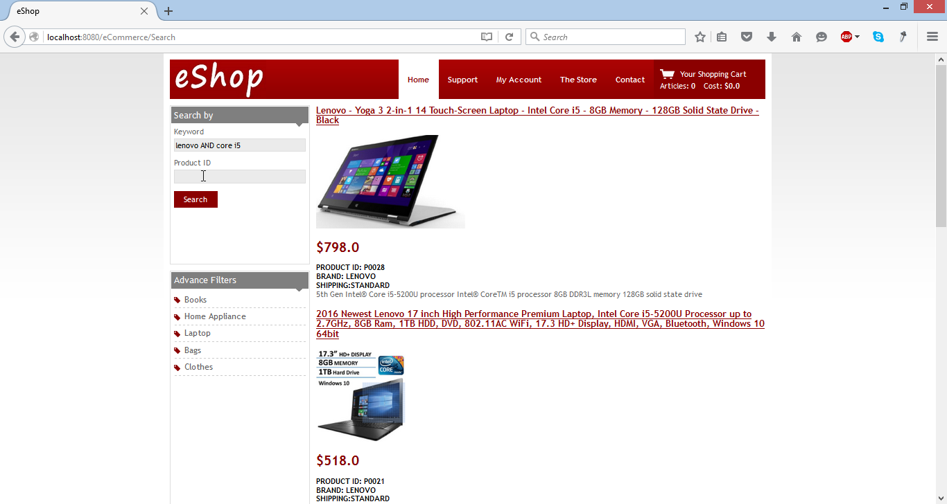
Full text search with document boosting

Slide 12
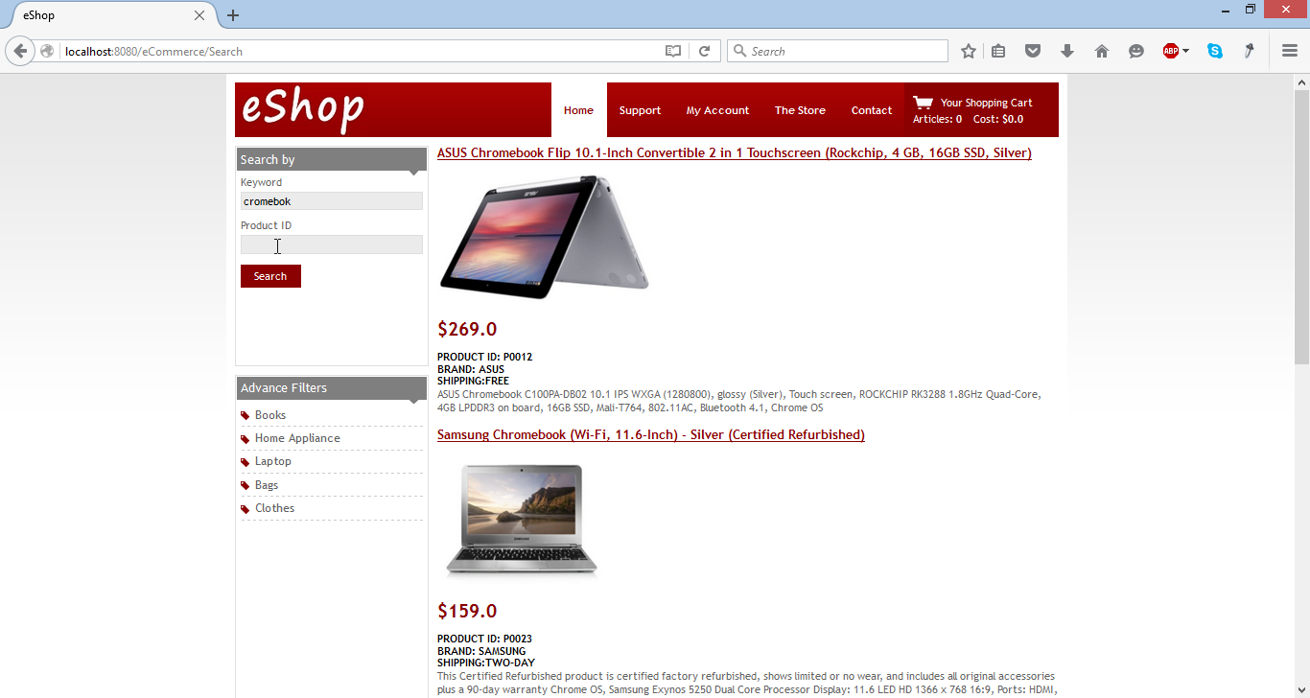
Fuzzy Search

Slide 13
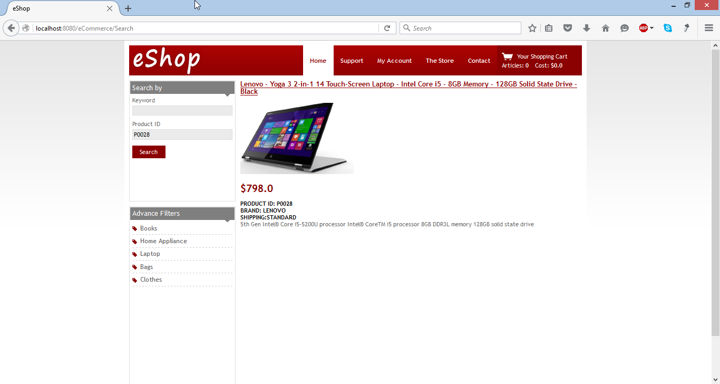
Search by Product Id

Slide 14
Thank You !

